Slide 1


Precidium™ Seamless Floor Systems
exclusively distributed by Axalta Coating Systems
Precidium™ MTI Bus Floor

Slide 2

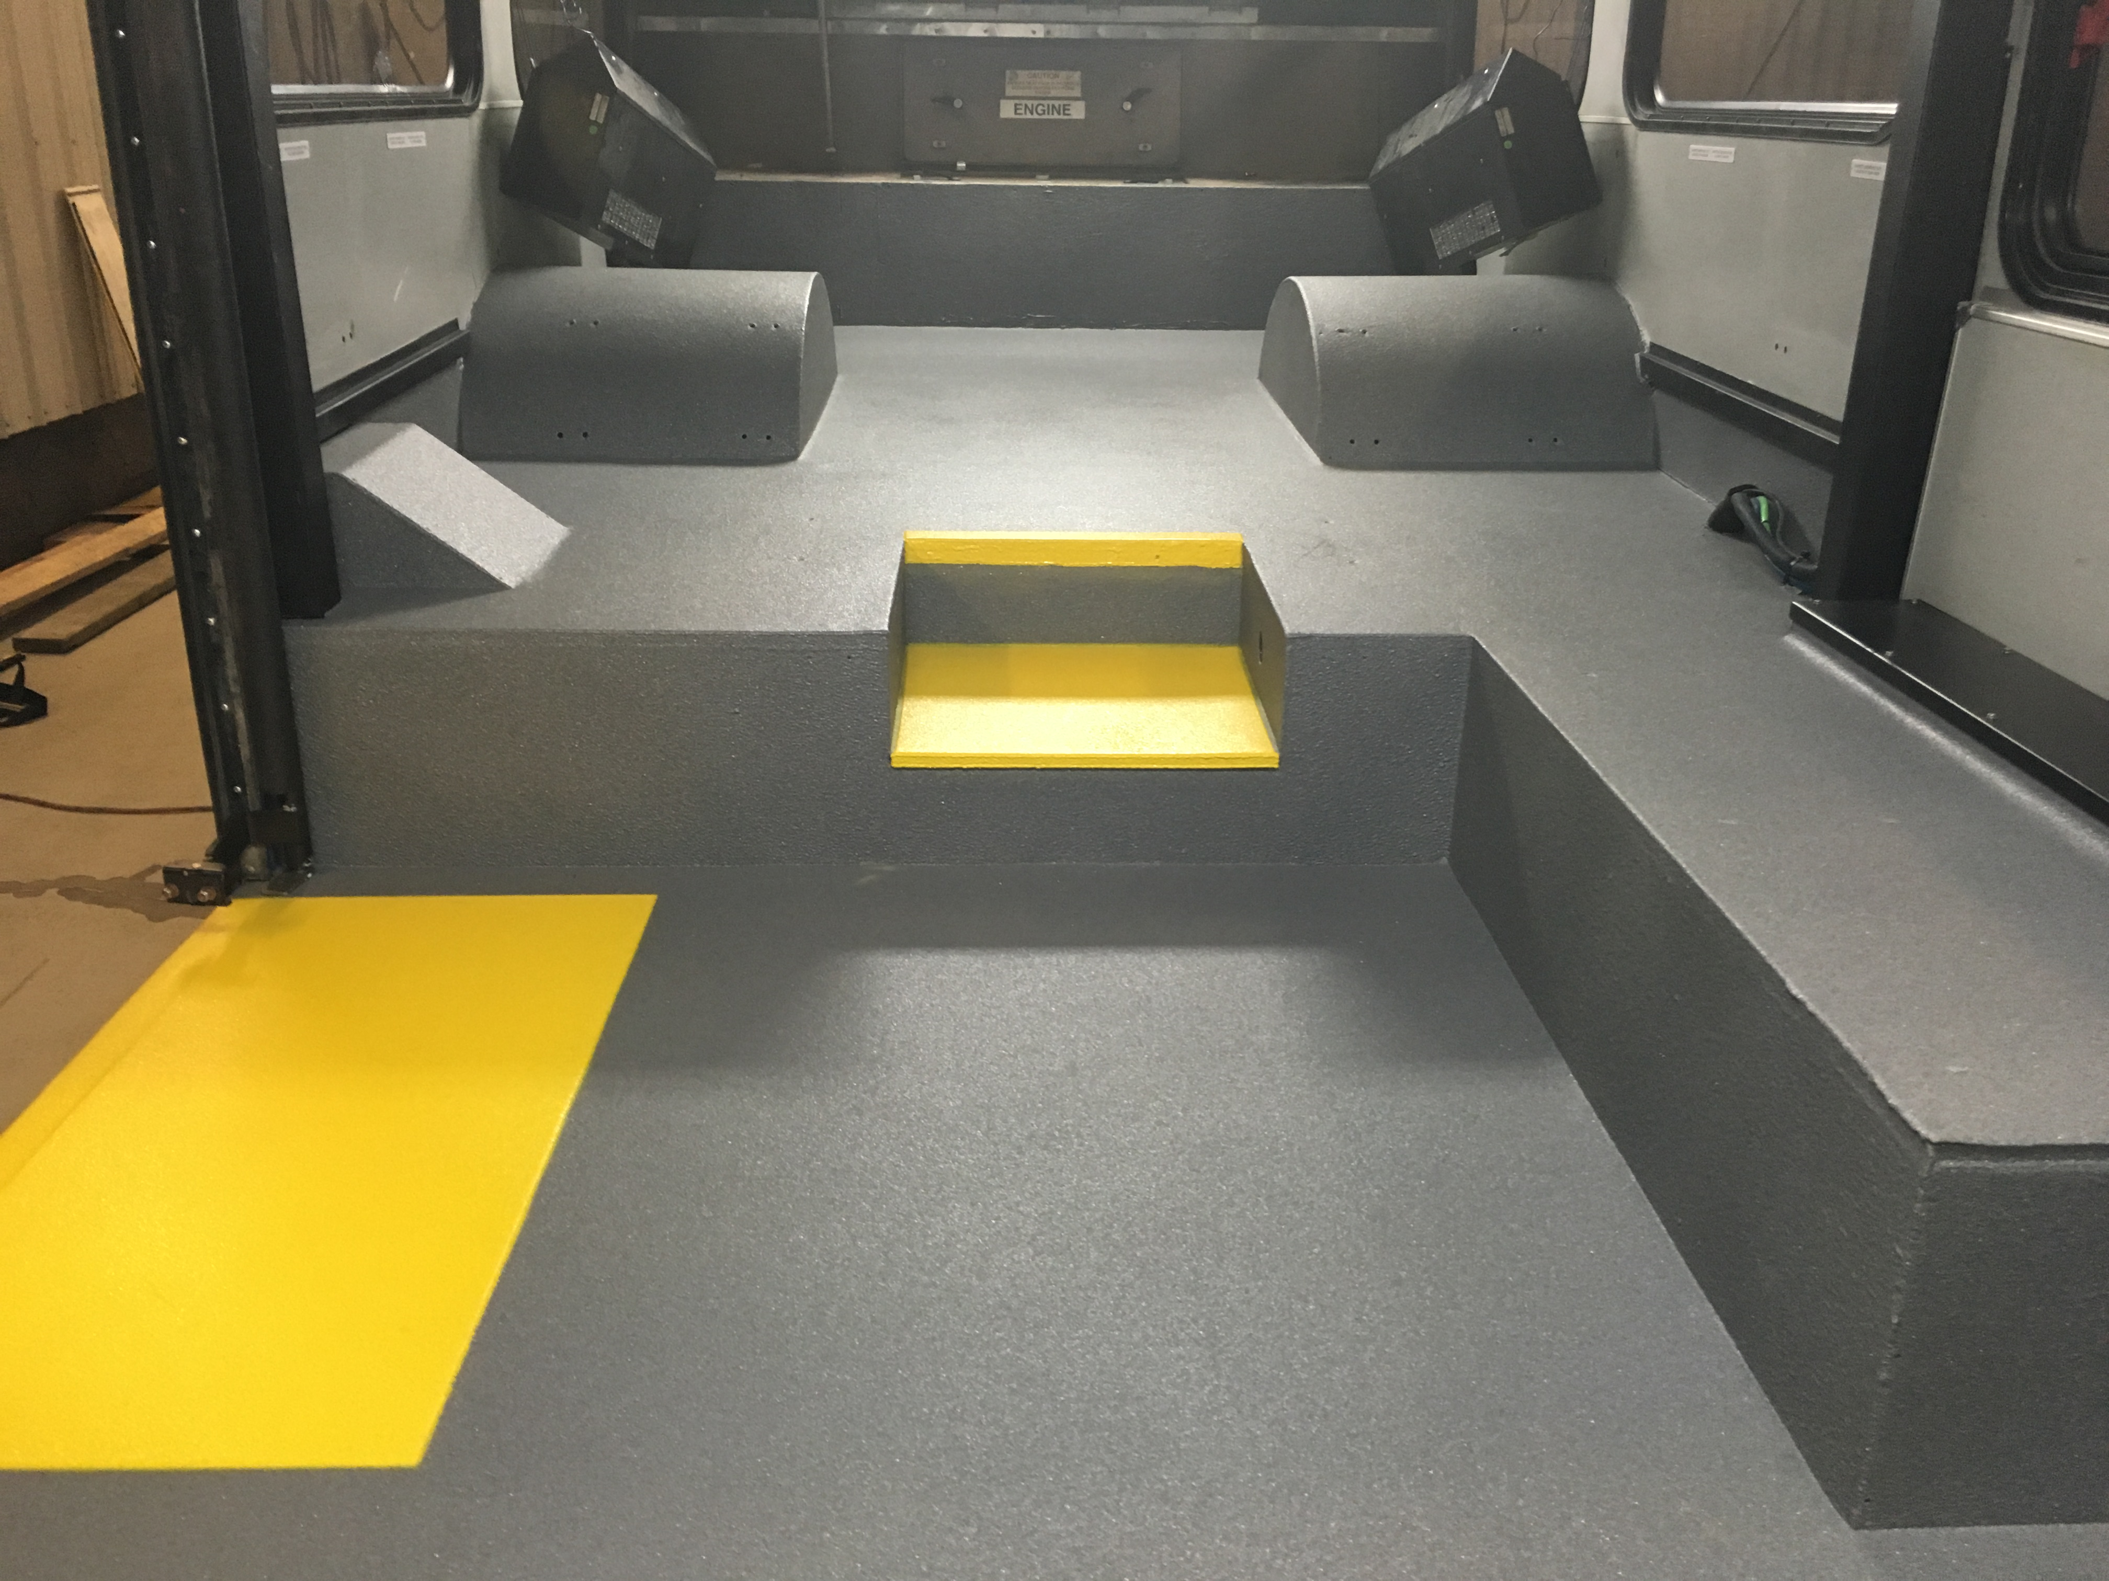
Precidium™ Seamless Floor Systems
exclusively distributed by Axalta Coating Systems
What is Precidium™ MTI Bus Floor?
100% Solids, High Performance two-component proprietary elastomer
Seamless and durable spray applied floor
Anti-slip characteristics embedded throughout entire membrane
Productive Installation
  Features Include:
  Seamless Floor
  Zero VOC
  10% Post-consumer content
  Phthalate Free
  Excellent Abrasion and Impact Resistance
  Flexible and Waterproof
  Stain Resistant
  Lightweight

Slide 3

Precidium™ Seamless Floor Systems
exclusively distributed by Axalta Coating Systems
Unlike traditional transit floor coverings, Precidium™ MTI Bus Floor, is specifically engineered to meet the needs of the bus industry. It is an innovative, light-weight, seamless floor covering that allows Bus OEMs and Refurbisher’s to deliver significant benefits to Transit Properties:
  Maintenance friendly & easier to clean floor coverings.
  The elimination of seams ensures that dirt won’t collect between floor panels, ensuring that floors are cleaner and look cleaner to passengers.
  Excellent abrasion & adhesion properties results in floors that won’t wear quickly or delaminate under even the toughest weather conditions. Floors look newer, longer.
  Productive spray-applied installation eliminates time-consuming process steps and tasks related to traditional transit floor options

Slide 4
Precidium™ Seamless Floor Systems
exclusively distributed by Axalta Coating Systems
Product Attribute | Benefit to Transit Property
Spray applied coating
Creates a seamless and impermeable membrane | Prevents water and dirt from penetrating the surface and causing adhesion failure or corrosion of the substrate
Easy to maintain
Excellent stain resistance – including grease & oil | Its seamless nature means dirt can’t collect between panels, making it easy to clean and maintain for a pleasant commuter experience
Quick and Easy to Install
Productive spray applied coating process | Time-consuming tasks of molding, cutting, fitting and handling materials are completely eliminated to saves cost and minimizes asset downtime
Extremely durable
Exceptional abrasion and impact resistance | Extends the life of the floor, decreases maintenance costs and won’t show the wear and tear from thousands of daily commuters
High performance
Proprietary elastomer technology | Combines a soft, comfortable and safe feel underfoot with aesthetically pleasing design providing a high level of commuter satisfaction.

Slide 5
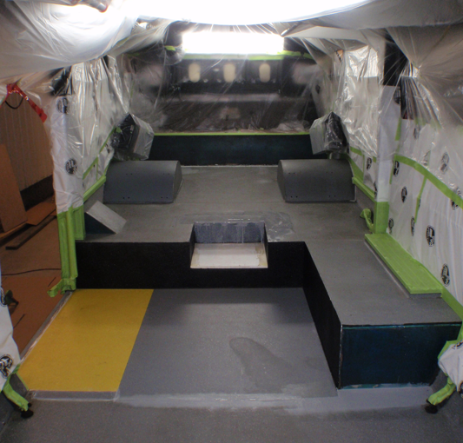
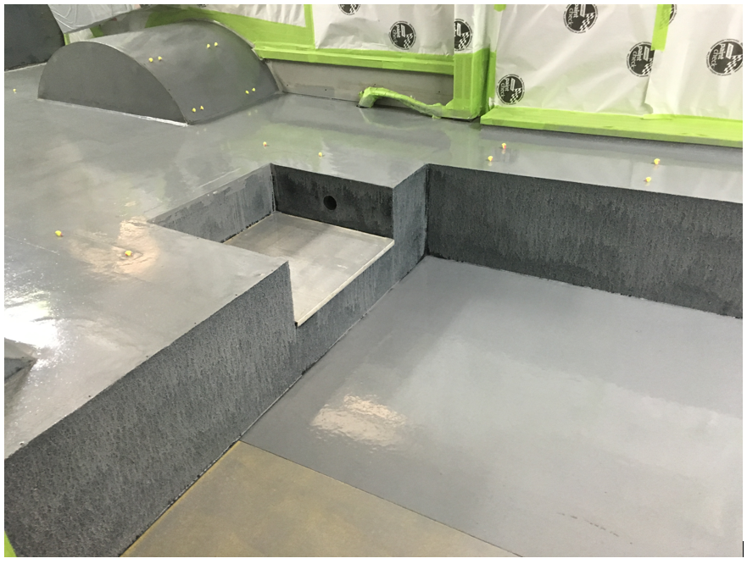
Precidium™ Seamless Floor Systems
exclusively distributed by Axalta Coating Systems
Precidium™ MTI Bus Floor Application
(pictures are of a refurbished transit floor)
Pre-Installation Preparation
  All transitions filled and leveled
  Wire tape installed
  Vehicle masked
  Final Surface preparation
  Quality Inspection report
Precidium™ MTI Primer coat (if required, pending substrate type and preparation)
  Spray applied or rolled on in 1-2 coats at 2-3 mil/coat
  Flash 3 hours air dry before Membrane application

Slide 6
Precidium™ Seamless Floor Systems
exclusively distributed by Axalta Coating Systems
Precidium™ MTI Bus Floor Application
Precidium MTI Bus Floor Membrane
  Apply with a High-Pressure Plural Component proportioner (1:1) system capable of producing 2500-3500 psi; Graco H-XP2 with a Fusion AP gun or equivalent
  Set recirculation temperature, ensure material agitation and purge gun
  Step 1 Cut in all corners, edges and hard to reach areas
  Step 2 Apply 1st membrane coat – target 30 mils – even speed and overlapping strokes
  - Material sets in 2 minutes; can walk over 1st pass with clean feet in 2-5 minutes after application
  Step 3 Apply 2nd membrane coat – target 30 mils – even speed and overlapping strokes
  - Material sets in 2 minutes; can walk over 2nd pass with clean feet in 2-5 minutes after application
  Step 4 Apply texture coat – light overspray application method, repeat as needed to achieve desired texture and even application coverage

Slide 7
Precidium™ Seamless Floor Systems
exclusively distributed by Axalta Coating Systems
Precidium™ MTI Bus Floor Application
Precidium MTI Bus Floor Membrane – Safety Yellow Accents
  Apply with a High-Pressure Plural Component proportioner (1:1) system capable of producing 2500-3500 psi; Graco H-XP2 with a Fusion AP gun or equivalent
  Set recirculation temperature, ensure material agitation and purge gun
  Step 1 Cover area not be coated with a pre-cut tarp
  Install templates for hazard markings
  Step 2 Apply Color to hiding – even speed and overlapping strokes (20-30 mils pending opacity of color)
  Step 3 Apply texture coat – light overspray application method, repeat as needed to achieve desired texture and even application coverage

Slide 8
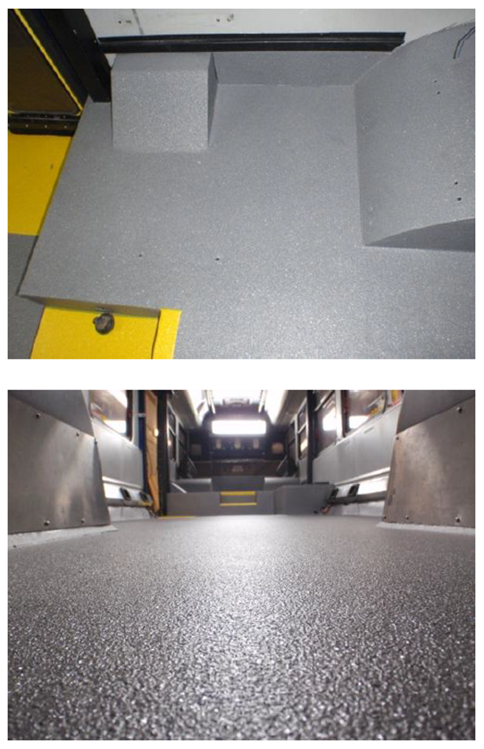
Precidium™ Seamless Floor Systems
exclusively distributed by Axalta Coating Systems
Precidium™ MTI Bus Floor Application
Post Spray
  After application complete – 5-10 minutes
    Pull Wire tape (sooner than later, same day recommended)
    Remove Masking
  Quality Inspection post spray
  Installation Time Summary:
  Surface Prep: consistent with vinyl / rubber floor
  Primer if required, 3 hours
  Membrane 30 minutes
  Safety Accents 30 minutes
  * Time summary is based on a refurbished floor

Slide 9
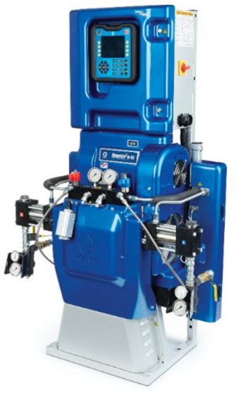
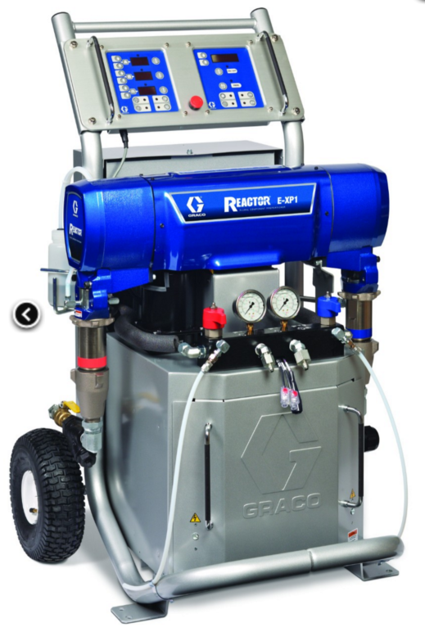
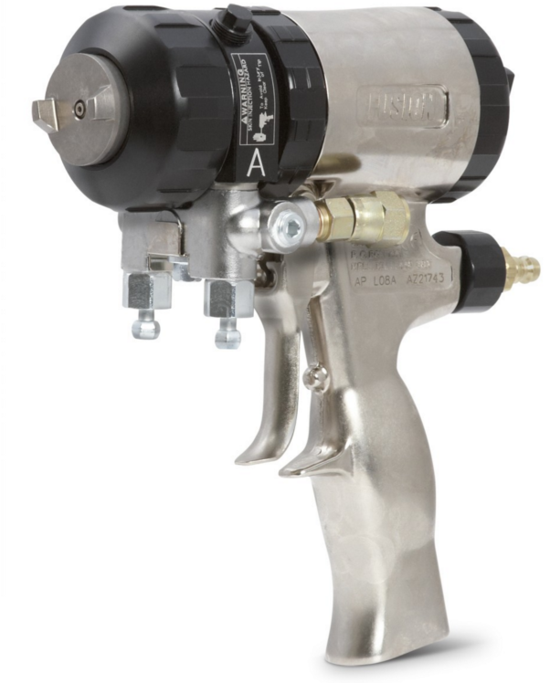
Precidium™ Seamless Floor Systems
exclusively distributed by Axalta Coating Systems
  Equipment Info:
  High-Pressure Plural Component proportioner (1:1) system capable of producing 2500-3500 psi; example Graco H-XP2
  Fusion AP gun or equivalent

Slide 10
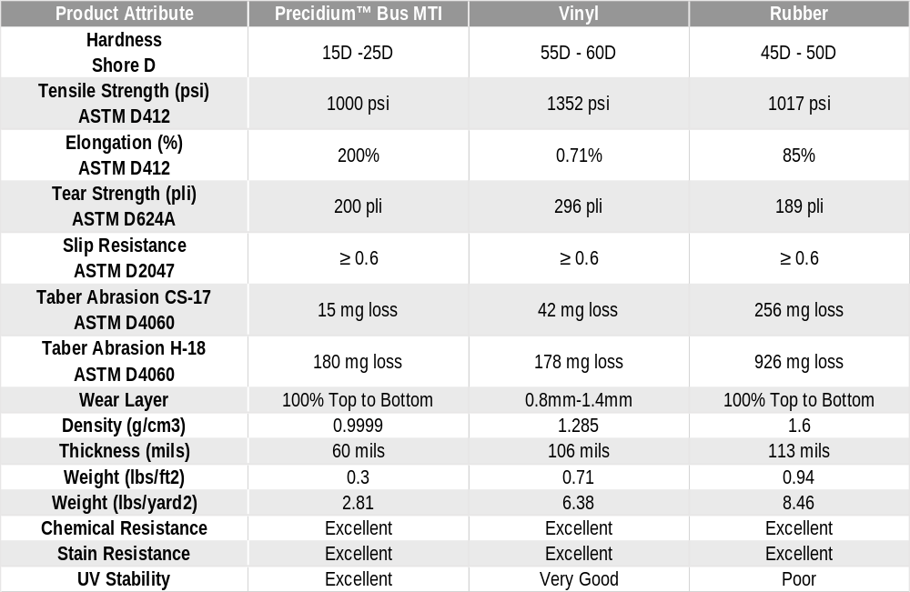
Precidium™ Seamless Floor Systems
exclusively distributed by Axalta Coating Systems

Slide 11
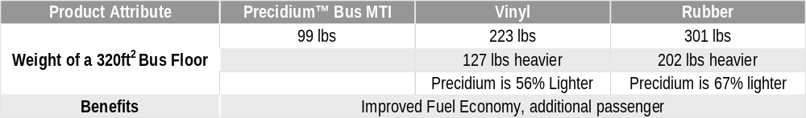
Precidium™ Seamless Floor Systems
exclusively distributed by Axalta Coating Systems
Weight savings
Graffiti resistance
  Tests in process
Docket 90
  Tests in process

Slide 12
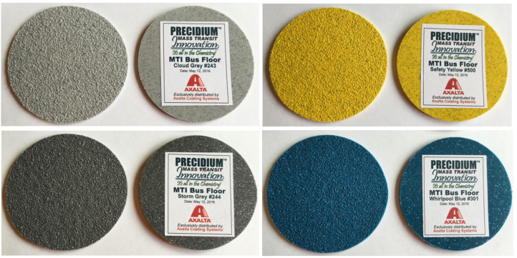
Precidium™ Seamless Floor Systems
exclusively distributed by Axalta Coating Systems
Color Samples – 3 shades of grey available – custom color can be evaluated

Slide 13
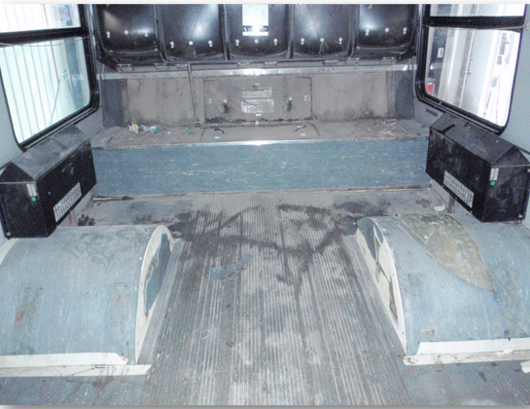
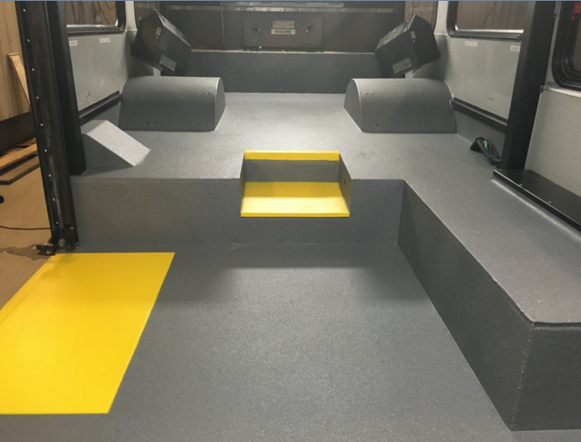
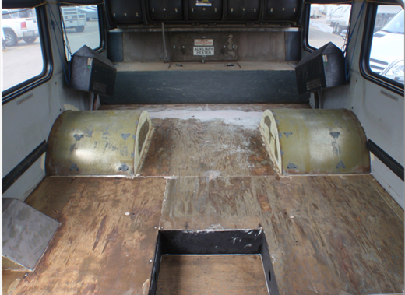
Precidium™ Seamless Floor Systems
exclusively distributed by Axalta Coating Systems
Example of a Bus refurbishment

Slide 14
Installation Options
Use an Installer:
  No upfront equipment cost
  Turnkey operation
  Contractor onsite
  Cost considerations
  Low training costs
  Experienced applicators
Proterra Install:
  Upfront equipment cost $50K - $60K
  Not a turnkey operation
  No contractor onsite
  Cost considerations
  Some training costs
Successful application requires strict adherence to the SOPs and Quality documentation.

Slide 15
Proterra / Axalta Next Steps
Demo Plan
Contractor or self install model
Equipment considerations quote
Installer considerations quote
Color styling
Process review

Slide 16
Questions
Floor Substrate and Preparation Process – SOP for current floor process
Time available for line moves
At which stage of bus build is floor currently installed, and what is the general bus build process by steps
Surface area of floor to be coated
Any thickness restrictions at doors etc
Sample of substrate for adhesion testing

Slide 17
Thank you

